Slide 1
CS 454: Software Engineering-3 Mobile Software Engineering Mobile Operating Systems Basics

Slide 2
Introduction
This unit provides basic knowledge about mobile operating system concepts that are necessary for mobile applications development.
Introduce students to mobile applications development frameworks and tools.

Slide 3
List of topics
Android architecture overview
Android development environment
Android fundamentals
Android user interface
Android data storage

Slide 4

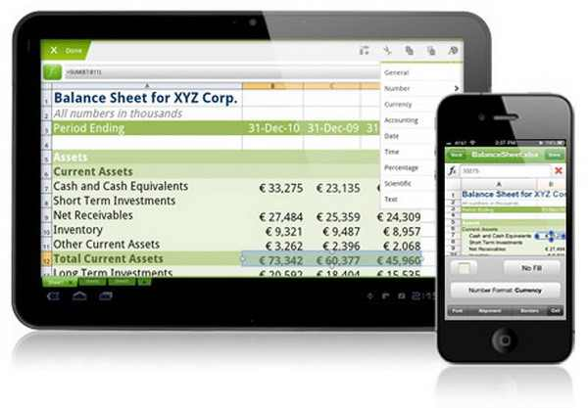
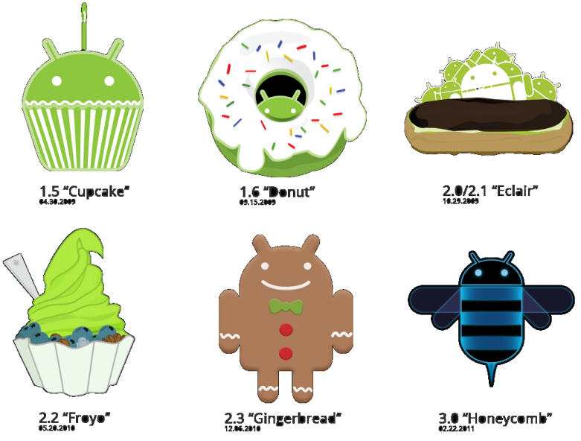
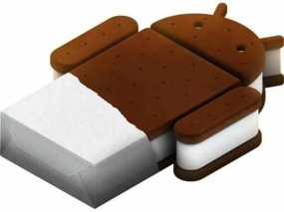
What is Android?
A robot with a human appearance.
Platform for mobile devices:
Cell + Tablets
OS + API + SDK
Linux-based
Open source (Symbian? Windows Mobile? iOS? BBOS?)
History:
@2003, Android, Inc. established.
@2005, Google acquired Android, Inc.
@2007, The OHA was unveiled.
@2007, v1.0 beta
@2009, v1.5, v1.6, and v2.0
@2010, v2.2, and v2.3
@2011, v3.0, and v4.0
@2012, v4.1
@2013, v4.4
Notes:
OHA: Open Handset Alliance: Sony, Dell, Intel, Motorola, LG, nVidia, Google
Honeycomb: Tablets only

Slide 5



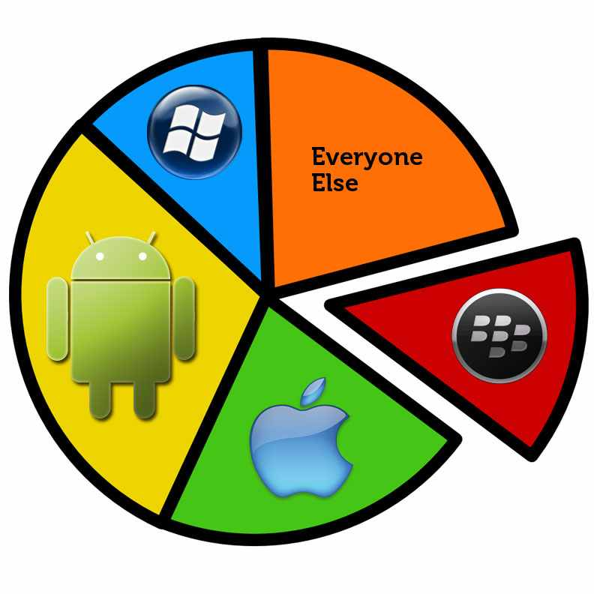
Why Android?
Java based
Open source
Android Market
Faster, cheaper than Apple’s
Growing market share
Notes:
Android: one-time $25
Apples: annual $99 (Can’t test without it)

Slide 6
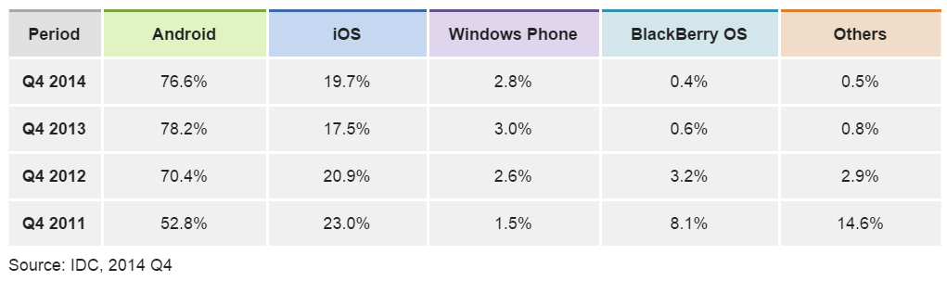
Android Market Share
Source: http://www.idc.com/prodserv/smartphone-os-market-share.jsp
Notes:
Android: one-time $25
Apples: annual $99 (Can’t test without it)

Slide 7
Android Architecture Overview
Applications
Application Framework
Libraries + Dalvik
Kernel / Drivers
Notes:
Kernel: Display/Camera/Keypad/WiFi/Bluetooth/Audio/Flash memory/…
Libraries: Graphics/Media/Database/WebKit Libraries in C/C++
Graphics: SGL (2D) and OpenGL (3D)
Media: OpenCORE for recording/playback of audio/video/image files.
Database: SQLite RDB
WebKit: HTML Rendering engine (Chrome/Safari)
Dalvik: JVM
Framework: Android-specific Java libraries
Applications: Programs you develop and pre-built ones [Email/SMS/Maps/Calendar/Contacts/Browser]

Slide 8
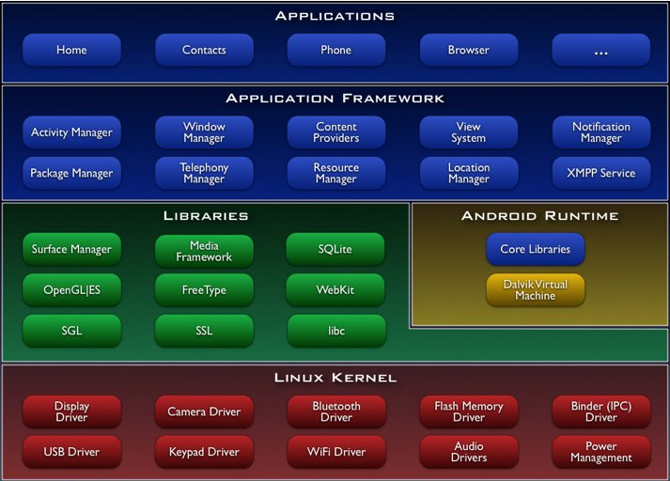
Android Platform Architecture
Notes:
Kernel: Display/Camera/Keypad/WiFi/Bluetooth/Audio/Flash memory/…
Libraries: Graphics/Media/Database/WebKit Libraries in C/C++
Graphics: SGL (2D) and OpenGL (3D)
Media: OpenCORE for recording/playback of audio/video/image files.
Database: SQLite RDB
WebKit: HTML Rendering engine (Chrome/Safari)
Dalvik: JVM
Framework: Android-specific Java libraries
Applications: Programs you develop and pre-built ones [Email/SMS/Maps/Calendar/Contacts/Browser]

Slide 9
Android Platform Architecture
Linux Kernel
Hardware drivers for Display, Camera, Keypad, WiFi, Bluetooth, Audio,Flash memory, etc…
Native C/C++ Libraries
Graphics: SGL (2D) and OpenGL (3D)
Media: OpenCORE for recording/playback of audio/video/image files.
Database: SQLite relational database engine
WebKit: HTML Rendering engine (Chrome/Safari)
Notes:
Image description Describe with an alternative text
To help the designer to describe how this topic should appear on the screen, such as sequence of appearance of its parts, stress in some parts. This helps the development team to design the screens.

Slide 10
Android Platform Architecture
Android Runtime
Java API Framework: Android-specific Java libraries
Dalvik Java Virtual Machine
Notes:
Image description Describe with an alternative text
To help the designer to describe how this topic should appear on the screen, such as sequence of appearance of its parts, stress in some parts. This helps the development team to design the screens.

Slide 11
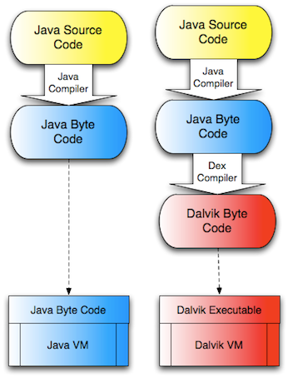
Sun/Oracle VM vs. Dalvik VM

Slide 12
Android Platform Architecture
Application Framework
View System used to build an app’s UI, including lists, grids, text boxes, buttons, and even an embeddable web browser
Resource Manager provides access to non-code resources such as localized strings, graphics, and layout files
Notification Manager enables all apps to display custom alerts in the status bar
Activity Manager manages the lifecycle of apps
Content Providers enable apps to access data from other apps, such as the Contacts app, or to share their own data
Applications
Programs users develop and pre-built apps [Email/SMS/Maps/Calendar/Contacts/Browser]
Notes:
Image description Describe with an alternative text
To help the designer to describe how this topic should appear on the screen, such as sequence of appearance of its parts, stress in some parts. This helps the development team to design the screens.

Slide 13
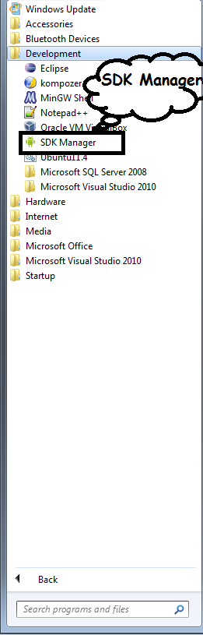
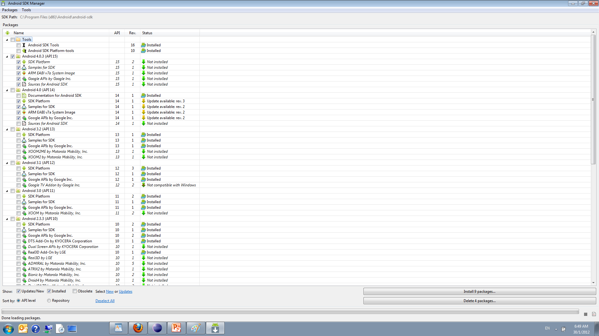
Android Development Environment
Install Eclipse (min. 3.5)
Install Android SDK [r24]
Install SDK Platforms
Update Path variable [/tools and /platform-tools]
Install Eclipse Plugin (ADT)
[https://dl-ssl.google.com/android/eclipse/]
Configure Eclipse Plugin
Window → Preferences → Android → SDK Location
Notes:
ADT: Android Development Tools

Slide 14
NDK and AVD Manager
NDK:
Native Development Kit
C/C++ Code
Signal processing, physics simulation, games…
Faster, but harder
AVD Manager:
Android Virtual Device Manager
Creates virtual devices for testing

Slide 15



Android Fundamentals
Application = Components
Activity
Single Window with a UI
Service
Executable code without a window
Runs in the background
Can be started by an activity
Content provider
Provides access to data (files, SQLite DB, Web, phone contacts…)
Broadcast receiver
Listens to system-wide broadcast announcements, e.g. battery low
Receives an Intent
Initiates an activity or a service
Notes:
Activity that shows a list of new emails
Activity to compose a new email
Activity for reading emails
Service for playing music.
Service for downloading data over the network.
Broadcast receiver listens to: Low battery, charger connected, …

Slide 16
Android Activity Lifecycle
When the activity is on the foreground of the application, it is the running activity. Only one activity can be in the running state at a given time.
If the activity loses focus but remains visible (because a smaller activity appears on top), the activity is paused.
If the activity is completely covered by another running activity, the original activity is stopped. When an activity stops, the user will lose any state and will need to re-create the current state of the user interface when the activity is restarted.
While the activity is paused or stopped, the system can kill it if it needs to reclaim memory. The user can restart the activity.

Slide 17
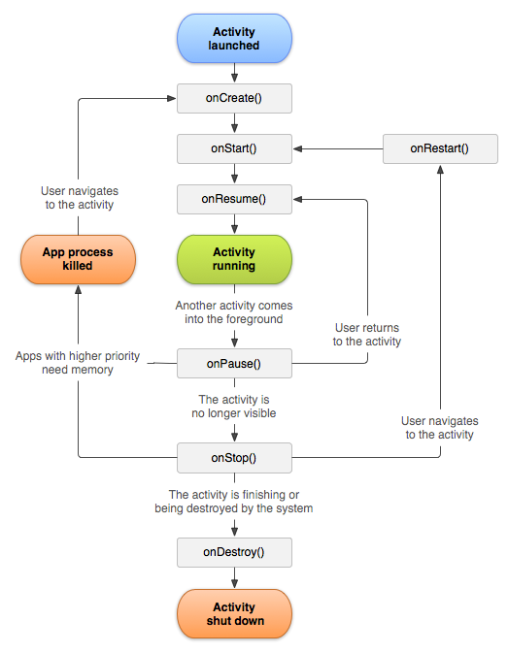
Activity Lifecycle
Entire Lifetime
Visible lifetime
Foreground lifetime
Notes:
Entire lifetime between onCreate(Bundle) and onDestroy(). [Acquire/release resources]
Visible lifetime between onStart() and onStop(). []
Foreground lifetime onResume() onPause(). [Receives user interaction]

Slide 18
Android Activity Callbacks
Callback Method | Purpose
OnCreate() | when the activity is first created, used to initialize data used through out the lifecycle of the app
OnStart() | when the activity becomes visible to the user, used to write code that affects the UI of the application
OnResume() | when the activity is running in the foreground and the user can interact with it
OnPause() | when another activity comes to the foreground. Needs quick implementation, because the other activity cannot run until this method returns.

Slide 19
Android Activity Callbacks
Callback Method | Purpose
OnStop() | when the activity is invisible to the user
OnDestroy() | called by the system before the activity is destroyed
OnRestart() | when the activity restarts after stopping it

Slide 20
Components
An application can start a component in another application.
Your application can start “capture a photo” component of the Camera application.
Steps:
Your application sends a message (an Intent object ) to Android
Android starts the required component

Slide 21
Intents
Intent class
Asynchronous message
Activates a component
Action to perform (Send file)
Input parameter (File address)
Returns a result
Selected contact from the contacts list

Slide 22
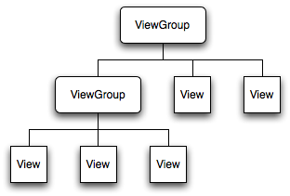
Android GUI Concepts
Widgets
Visible rectangles
Properties / Events / Methods
Button, Textbox, Label, Radio, Check…
aka : Views
Layouts
Invisible containers
Contain other layouts or widgets
Horizontal, Vertical, Grid, Relative…
aka : Viewgroups
Menus
Notes:
A window/activity is assigned one ViewGroup to be the root view

Slide 23
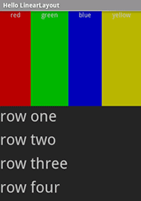
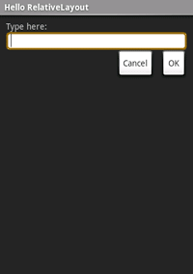
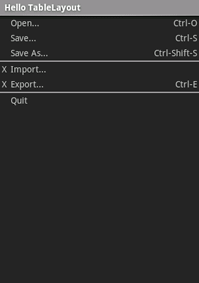
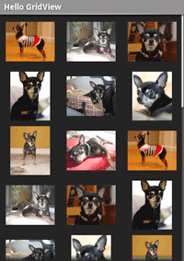
Layouts
Notes:
Linear
Relative
Table
Grid
Tab
List

Slide 24
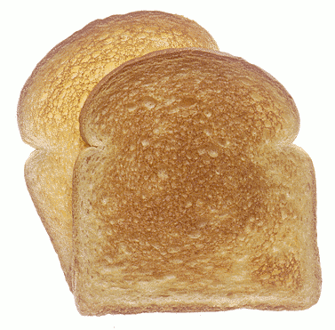
Toast
Provides simple feedback about an operation in a small popup
Only fills the amount of space required for the message and the current activity remains visible and interactive
For example, navigating away from an email before you send it triggers a "Draft saved" toast to let you know that you can continue editing later
Toasts automatically disappear after a
timeout

Slide 25
Android Data Storage
Android supplies three data storage facilities:
key-value pairs
files
SQLite database
Over the network

Slide 26
References
https://developer.android.com/guide/index.html
https://www.tutorialspoint.com/android/
Chapter 6, Professional Mobile Application Development, Jeff McWherter and Scott Gowell, Wrox; 1 edition (September 4, 2012),

Slide 27
Assignment
Form a group of two students
Search for an open source simple Android app of your choice
Download the source code
Run the app on an emulator or on your phone
Understand the code carefully
Submit a description of the code and snapshots of the app in the next lecture

Slide 28
Thank you for
your attention.

